Slide 1
Introduction to SQL
By
Sajid Ahmed Rahi
Student of Dept. of IoT & Robotics Engineering
University of Frontier Technology, Bangladesh

Slide 2
What is SQL?
SQL stands for Structured Query Language. It is used to store, retrieve, update, and delete data in Relational Database Management System (RDBMS).
It is a standard language for Relational Database System. It enables a user to create, read, update and delete relational databases and tables.
All the RDBMS like MySQL, Informix, Oracle, MS Access and SQL Server use SQL as their standard database language.
SQL allows users to query the database in a number of ways, using English-like statements.

Slide 3
What are the SQL?
SQL follows the following rules:
Structure query language is not case sensitive. Generally, keywords of SQL are written in uppercase.
Statements of SQL are dependent on text lines. We can use a single SQL statement on one or multiple text line.
Using the SQL statements, you can perform most of the actions in a database.
SQL depends on tuple relational calculus and relational algebra.

Slide 4
Process of SQL
When an SQL command is executing for any RDBMS, the system automatically figure out the best way to carry out the request and the SQL engine determines how to interpret the task.
In the process, various components are included. These components can be optimization Engine, Query engine, Query dispatcher, classic, etc.
All the non-SQL queries are handled by the classic query engine, but SQL query engine won't handle logical files.

Slide 5
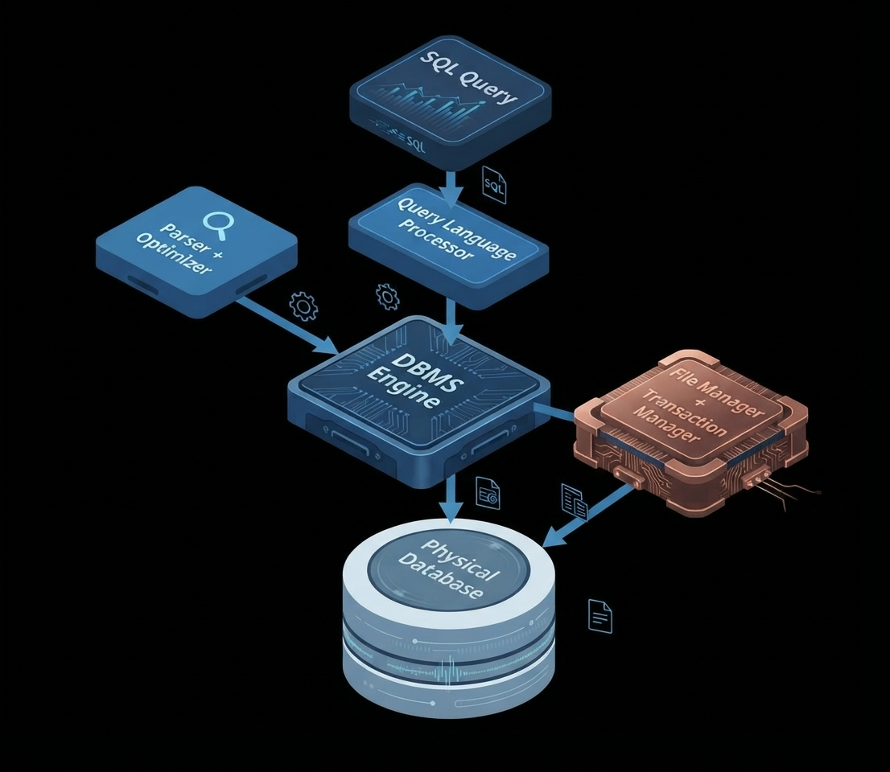
Process of SQL

Slide 6
Advantages of SQL
High-Speed Performance
SQL is optimized to query and retrieve vast amounts of data quickly and efficiently. Unlike spreadsheets that slow down when handling thousands of rows, SQL databases can process millions of records in seconds.
No Complex Coding Required
SQL uses a declarative language structure based on simple, English-like keywords (such as SELECT, INSERT, UPDATE, and DELETE). Users only need to state what data they want to see, rather than writing complex logic on how to find it. This makes it accessible to both developers and non-technical business analysts.

Slide 7
Advantages of SQL
Highly Standardized and Portable
SQL is an ANSI and ISO standardized language. This means that the core syntax remains virtually identical whether you are working on MySQL, PostgreSQL, Oracle, or Microsoft SQL Server. Additionally, it is highly portable across different devices, platforms, and servers.
Data Integrity and Robust Security
SQL databases utilize strict rules and constraints (like primary keys and foreign keys) to ensure data remains accurate, reliable, and organized. They also offer granular security features, allowing database administrators to control exactly who can view or modify specific tables using Role-Based Access Control (RBAC).

Slide 8
Advantages of SQL
Multi-User and Transaction Control
Through ACID (Atomicity, Consistency, Isolation, and Durability) compliance, SQL guarantees that database transactions are processed reliably. If a system crashes mid-transaction, SQL can ROLLBACK the changes to prevent data corruption, ensuring partial updates never ruin your datasets.

Slide 9
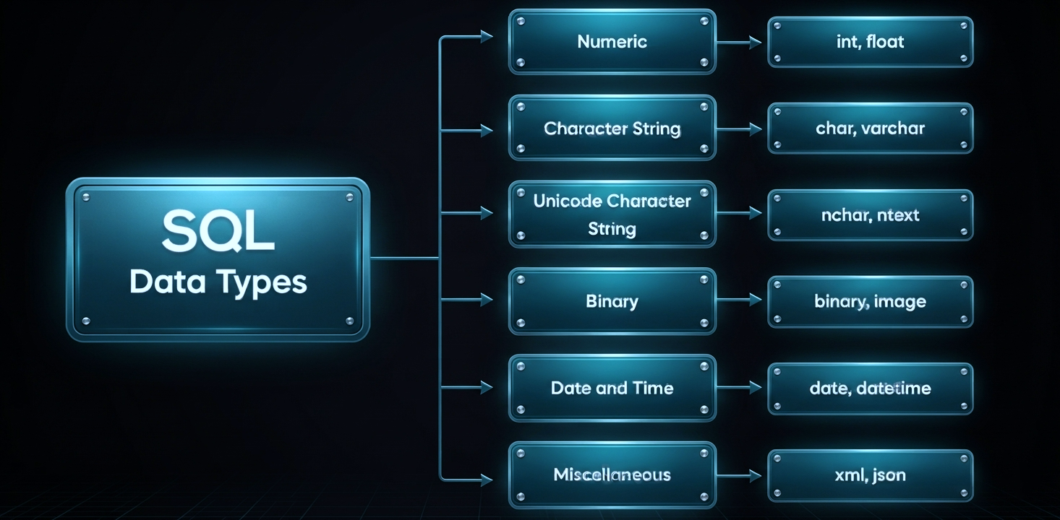
Datatypes in SQL
SQL Datatype is used to define the values that a column can contain.
Every column is required to have a name and data type in the database table.

Slide 10
SQL Commands
SQL commands are instructions. It is used to communicate with the database. It is also used to perform specific tasks, functions, and queries of data.
SQL can perform various tasks like create a table, add data to tables, drop the table, modify the table, set permission for users.
There are five types of SQL commands: DDL, DML, DCL, TCL, and DQL

Slide 11
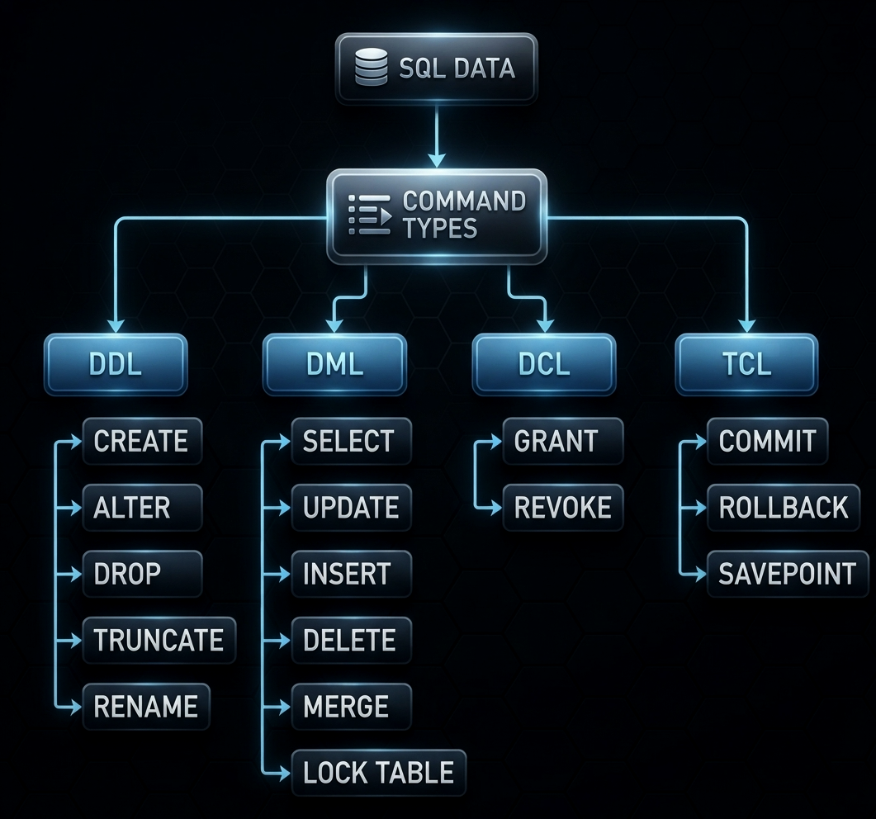
SQL Commands

Slide 12
SQL Commands
Data Definition Language (DDL)
DDL changes the structure of the table like creating a table, deleting a table, altering a table, etc. All the command of DDL are auto-committed, that means it permanently save all the changes in the database.
Here are some commands that come under DDL:
  CREATE
  ALTER
  DROP
  ALTER
  DROP
  TRUNCATE

Slide 13
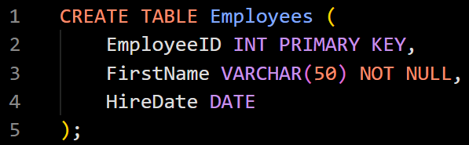
DDL SQL Commands
CREATE
This command builds a brand-new database object, such as a table, view, index, or schema. Sets up the name of the object, defines its columns, assigns data types, and enforces integrity rules like PRIMARY KEY or NOT NULL.

Slide 14
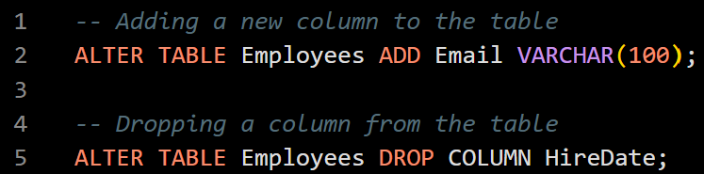
DDL SQL Commands
ALTER
The ALTER command modifies the structure of an existing database object without deleting it entirely. Used to add new columns, drop existing columns, change column data types, or add constraints to an already established table.

Slide 15
DDL SQL Commands
DROP
This command completely obliterates a database object from the system. Deletes the targeted object entirely—removing its structure, all of its stored data, and any associated permissions or triggers from the database.

Slide 16
DDL SQL Commands
TRUNCATE
TRUNCATE clears out the contents of a table while leaving its structural framework intact. Fast-deletes all rows from a table. Because it skips logging individual row deletions, it is significantly faster than using a DML DELETE command without a WHERE clause. The table will remain empty and ready for new data.

Slide 17
DDL SQL Commands
RENAME
This command changes the name of an existing database object. Allows you to change a table or column name to reflect updates in your database design without altering the underlying data.

Slide 18
SQL Commands
Data Manipulation Language (DML)
DML commands are used to modify the database. It is responsible for all form of CHANGES in the database.
The command of DML is not auto-committed that means it can't permanently save all the changes in the database. They can be rollback.
Here are some commands that come under DML:
  INSERT
  UPDATE
  DELETE

Slide 19
DML SQL Commands
INSERT
This command adds new rows of data into an existing table. Inserts literal values or data fetched from another table into specified columns.

Slide 20
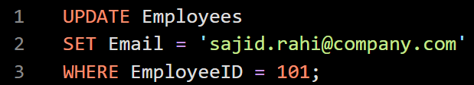
DML SQL Commands
UPDATE
The UPDATE command modifies existing records within a table. Changes the value of one or more columns for specific rows. It is highly critical to use a WHERE clause here; omitting it will update every single row in the table.

Slide 21
DML SQL Commands
DELETE
This command removes specific records from a table. Deletes rows that match a certain condition. Just like UPDATE, you must include a WHERE clause to avoid accidentally erasing all data in the table.

Slide 22

DML SQL Commands
SELECT
The SELECT command retrieves data from one or more tables. Allows to query the database, filter results, and view records without making any permanent alterations to the underlying data. Because of its read-only nature, some definitions separate it into its own category called Data Query Language (DQL).

Slide 23
SQL Commands
Data Control Language (DCL)
DCL commands are used to GRANT and TAKE BACK authority from any database user.
Here are some commands that come under DCL:
Grant
Revoke

Slide 24
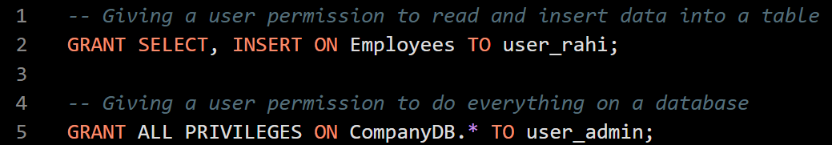
DCL SQL Commands
GRANT
This command assigns specific privileges or permissions to a user or database role. Allows administrators to give users the ability to read, write, modify, or delete data, as well as the ability to execute specific DDL commands.

Slide 25
DCL SQL Commands
REVOKE
This command withdraws previously assigned permissions from a user or role. Removes specific privileges, ensuring a user can no longer perform actions they were previously allowed to do.

Slide 26
DCL SQL Commands
Common Privileges Managed by DCL
When using GRANT or REVOKE, you typically specify one or more of the following privileges:
SELECT: Ability to look at or query the data.
INSERT: Ability to add new rows of data.
UPDATE: Ability to modify existing data.
DELETE: Ability to remove rows of data.
EXECUTE: Ability to run stored procedures or functions.
ALL PRIVILEGES: Grants all available structural and data permissions to the user.

Slide 27
SQL Commands
Transaction Control Language (TCL)
TCL commands can only use with DML commands like INSERT, DELETE and UPDATE only.
These operations are automatically committed in the database that's why they cannot be used while creating tables or dropping them.
Here are some commands that come under TCL:
  COMMIT
  ROLLBACK
  SAVEPOINT

Slide 28
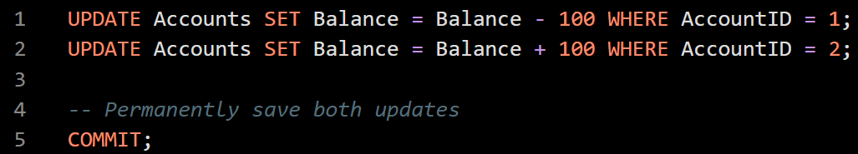
TCL SQL Commands
COMMIT
This command permanently saves all the changes made during the current transaction to the database. Once a COMMIT is executed, the changes become visible to other database users, and they cannot be undone using a rollback.

Slide 29
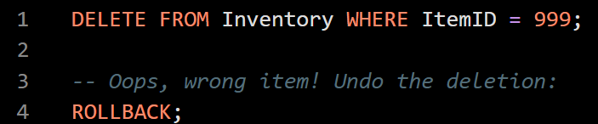
TCL SQL Commands
ROLLBACK
This command completely undoes or cancels the changes made in the current transaction. If an error occurs or a business rule is violated during a multi-step operation, ROLLBACK restores the database to its previous state before the transaction started.

Slide 30
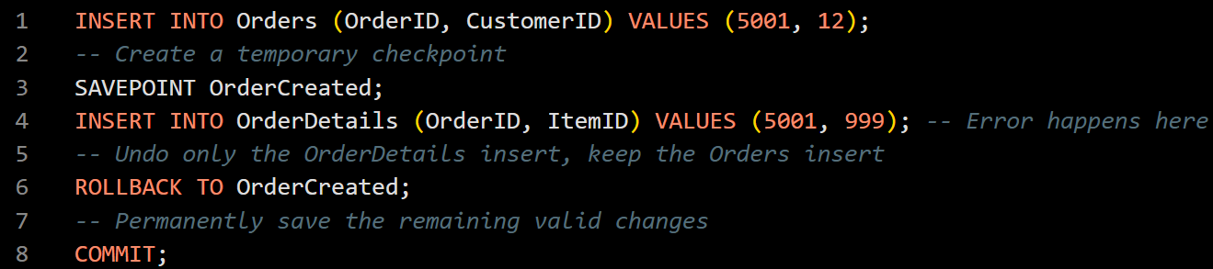
TCL SQL Commands
SAVEPOINT
This command creates a temporary checkpoint within a transaction. Instead of rolling back the entire transaction, you can use a savepoint to roll back only the specific operations that occurred after the checkpoint was created.

Slide 31
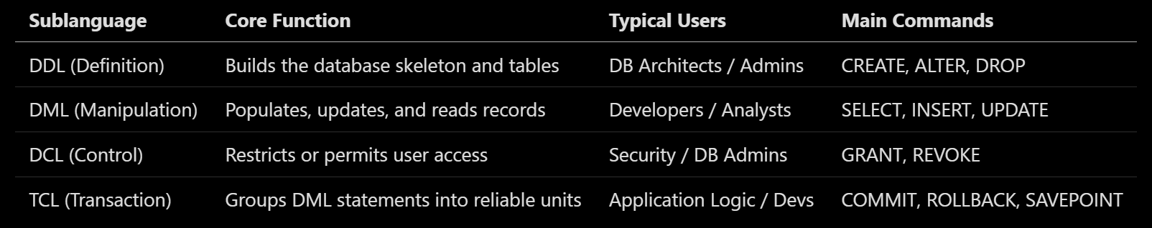
The Complete SQL Language Family

Slide 32
SQL Operators
SQL operators are reserved words or characters used in the WHERE clause of an SQL statement to perform operations, filter data, and combine multiple conditions. They are broadly categorized into Arithmetic, Comparison, Logical, and Bitwise operators.

Slide 33
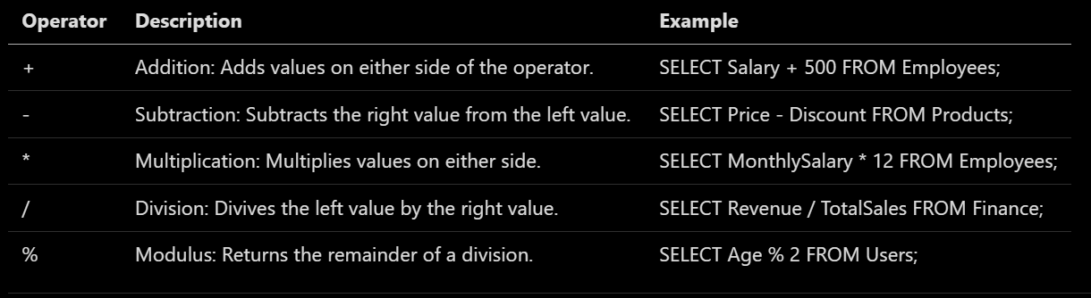
SQL Operators
Arithmetic Operators
These operators are used to perform mathematical calculations on numeric data.

Slide 34
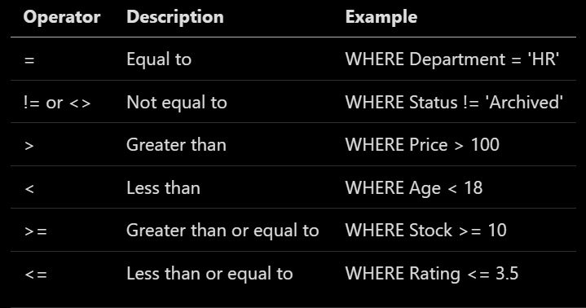
SQL Operators
Comparison (Relational) Operators
These operators compare two values and return a boolean result (TRUE or FALSE). They are heavily used to filter rows.

Slide 35
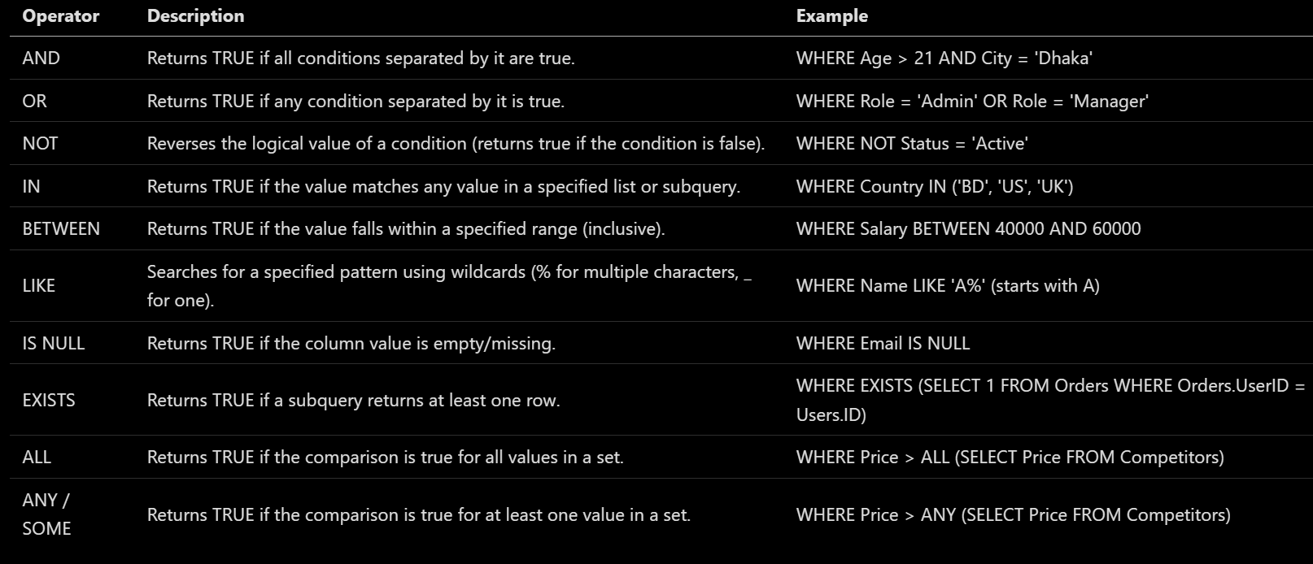
SQL Operators
Logical Operators
Logical operators combine multiple conditions or negate the truth value of a condition.

Slide 36
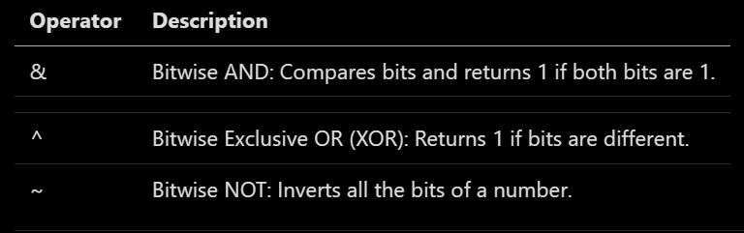
SQL Operators
Bitwise Operators
These operators perform bit-by-bit operations on integer data types. They are less common in standard data analysis queries but highly useful for low-level flag management.

Slide 37
SQL Operators Precedence
When we combine multiple operators in a single query, SQL evaluates them in a specific order:
  Parentheses () (Highest priority, forces evaluation order)
  Multiplication/Division (*, /), then Addition/Subtraction (+, -)
  Comparison operators (=, >, <, etc.)
  NOT
  AND
  OR (Lowest priority)

Slide 38
Views in SQL
An SQL View is a virtual table generated from the result of a pre-defined SQL SELECT query. Unlike a standard database table, a standard view does not store data physically on the disk. Instead, it acts as a dynamic blueprint or shortcut: every time you query the view, the database engine runs the underlying query in the background and presents the up-to-date data as if it were a real table.

Slide 39
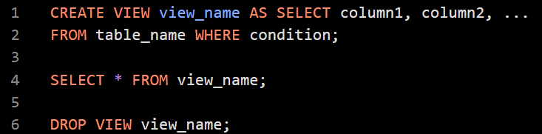
Views in SQL
Creating a View
A view can be created using the CREATE VIEW statement. We can create a view from a single table or multiple tables.

Slide 40
Views in SQL
Creating a View from multiple tables
Creating a view from multiple tables is one of the most powerful use cases for views. It allows you to pre-define complex JOIN queries, transforming scattered data across your database into a single, clean virtual table.
Practical Example: E-Commerce Orders
Imagine you have three separate tables in an online store database:
  Customers: Stores customer profiles.
  Orders: Stores order metadata (dates, statuses).
  Products: Stores product details.

Slide 41
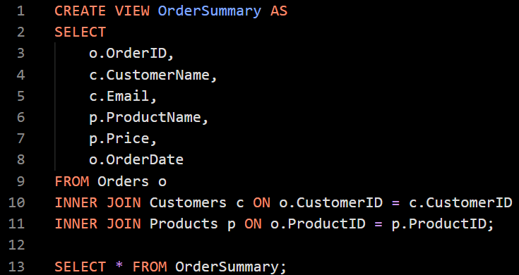
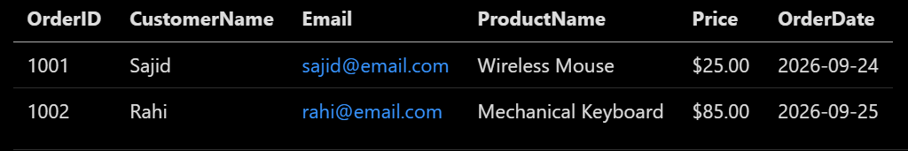
Views in SQL

Slide 42
Views in SQL
Key Advantages for Multi-Table Views
  Hides Schema Complexity: Database structures change. If you split the Products table into two tables later on, you only need to update the view's internal JOIN definition. Any application or user querying OrderSummary won't notice a difference, preventing breaking changes.
  Simplifies Reporting: Analysts and business teams who don't know how to write complex SQL joins can easily extract data using standard SELECT * FROM OrderSummary WHERE Price > 50; queries.
  Aggregated Views: You can easily mix joins with grouping functions (like SUM or COUNT) to create high-level dashboards, such as a CustomerLifetimeValue view.

Slide 43
Views in SQL
Crucial Rule for Multi-Table Views
While you can freely read data from a multi-table view, you generally cannot update, insert, or delete rows through it. Databases typically restrict write operations on views that involve JOIN, GROUP BY, or DISTINCT because the engine cannot definitively trace which underlying table should receive the modifications.

Slide 44
Why Use Views?
Data Security: Views let us restrict data access by hiding sensitive columns (like salaries or passwords) or specific rows from unauthorized users.
Query Simplification: Instead of writing massive, repetitive JOIN statements or complicated filters every day, we can save the query as a view and access it with one simple line.
Consistency: If multiple team members need the exact same dataset (e.g., "Active Users"), a view ensures everyone queries the exact same logical definition, reducing human error.
Zero Storage Footprint: Because standard views only store the text query definition and not the actual data rows, they take up virtually zero storage space.

Slide 45
SQL Index
An SQL Index is a powerful database optimization feature used to speed up data retrieval.
Think of a database table like a massive, 1,000-page textbook. If you want to find a specific topic without an index, you have to read the book page by page from the beginning—this is called a Table Scan.
An SQL Index works exactly like the index at the back of the textbook. It provides a sorted list of keywords along with pointers to the exact pages where they live, allowing the database engine to jump straight to the data you need (Index Seek).

Slide 46
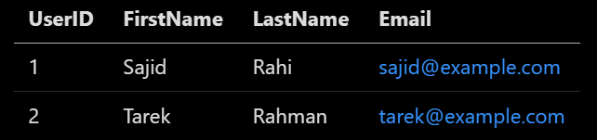
SQL Index
Practical Example
Imagine a Users table containing millions of rows:
If you frequently search for users by their email address, you run this query often:
Without an index, the database must look through every single row to find Sajid.

Slide 47
SQL Index
Creating the Index
To speed this up, you create an index on the Email column:
How the Database Uses It?
Behind the scenes, the database builds a hidden, highly organized structure (usually a B-Tree) containing just the emails and pointers to their physical rows. The next time you search for Sajid’s email, the engine searches the small index first, finds the pointer, and instantly grabs his row.

Slide 48
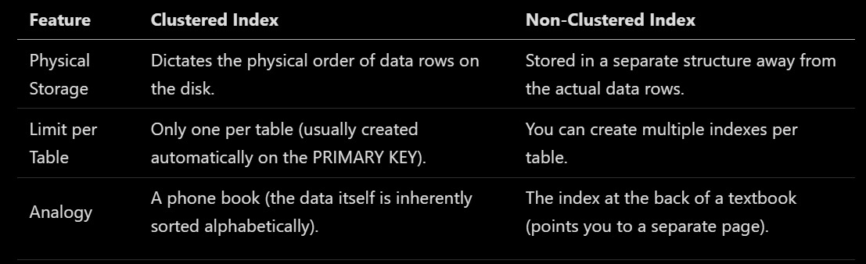
SQL Index
Clustered vs. Non-Clustered Indexes

Slide 49
SQL Index
The Cost of Performance (The Catch)
While indexes make reads incredibly fast, they come with trade-offs:
  Slower Writes: Every time you run an INSERT, UPDATE, or DELETE, the database must modify the data table and update all relevant indexes.
  Disk Space: Indexes are physical structures stored on the disk. Creating too many indexes on a single table can consume significant storage.
Golden Rule: Only index columns that are frequently used in WHERE clauses, JOIN conditions, or ORDER BY statements. Avoid indexing columns that are rarely searched or frequently modified. To help tailor our next database optimization topic, let me know:

Slide 50
SQL Sub-Query
A SQL subquery (also called an inner query or nested query) is a SELECT statement embedded inside another SQL statement (the outer query) used to handle multi-step data filtering, calculations, and retrieval.
How Subqueries Execute
  Execution Order: The database always runs the inner subquery first, producing a temporary result set in memory.
  Data Passing: The database then passes that temporary result to the outer query.
  Final Evaluation: The outer query finishes its run using the values provided by the inner query.

Slide 51
SQL Sub-Query
Basic Syntax Rules
  Parentheses: The subquery must always be enclosed in parentheses ().
  Structure: The inner block must always contain a SELECT keyword and a FROM clause.
  Operators: The outer query connects to the inner result using standard operators like =, >, <, or IN.

Slide 52
SQL Sub-Query
Where Subqueries Can Be Placed
  WHERE Clause: Used to filter rows dynamically based on computed values.
  FROM Clause: Used to create a temporary derived table that the outer query can read or join against.
  SELECT List: Used to calculate a single value alongside regular column outputs for every row.
  HAVING Clause: Used to filter group results after an aggregation step.

Slide 53
SQL Sub-Query
Main Types of Subqueries
  Scalar Subquery: Returns a single value (one row and one column).
  Multi-Row Subquery: Returns multiple rows with one column, often used with the IN operator.
  Non-Correlated Subquery: Runs independently of the outer query and can execute on its own.
  Correlated Subquery: Depends on the outer query and runs repeatedly for each row processed by the outer statement.

Slide 54
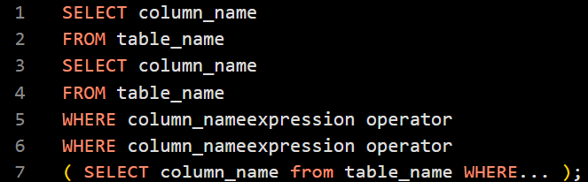

SQL Sub-Query
Syntax:
Example:

Slide 55
SQL Clauses
An SQL clause is a built-in keyword or command used to filter, group, sort, join, or restrict data within a query. While a statement represents the entire instruction (like a full SELECT statement), clauses serve as the individual building blocks that define how data is fetched and manipulated.

Slide 56
SQL Clauses
Data Retrieval & Source Clauses
SELECT: Specifies which columns or expressions the query should return in the final result set.
  Data Type/Role: Projection operator; accepts column names, literal values, or mathematical functions.
FROM: Identifies the primary table or views from which the database must pull the source records.
  Data Type/Role: Source locator; accepts table names, subqueries, or table-valued functions.

Slide 57
SQL Clauses
Data Filtering Clauses
WHERE: Filters individual rows before any grouping or aggregation takes place based on specific conditional criteria.
  Data Type/Role: Row-level predicate filter; accepts boolean expressions that evaluate to true or false.
HAVING: Filters aggregated groups after the GROUP BY clause has organized the data rows.
  Data Type/Role: Group-level predicate filter; accepts boolean expressions that contain aggregate functions (like SUM(), AVG()).

Slide 58
SQL Clauses
Data Organization & Aggregation Clauses
GROUP BY: Arranges raw data rows into summary groups sharing identical values in specified columns.
  Data Type/Role: Aggregator; accepts column names or expressions to define the grouping buckets.
ORDER BY: Sorts the final result set in either ascending (ASC) or descending (DESC) order.
  Data Type/Role: Sorter; accepts column names, aliases, or column index positions.

Slide 59
SQL Clauses
Row Restricting & Combination Clauses
LIMIT / TOP / FETCH: Restricts the maximum number of rows returned to the client application.
  Data Type/Role: Window limiter; accepts literal integer values. Note that LIMIT is standard in MySQL/PostgreSQL, TOP is used in SQL Server, and FETCH NEXT is ANSI SQL compliant.
JOIN: Combines rows from two or more tables based on a related column shared between them.
  Data Type/Role: Relation combiner; evaluates logical conditions linked via the ON keyword.

Slide 60
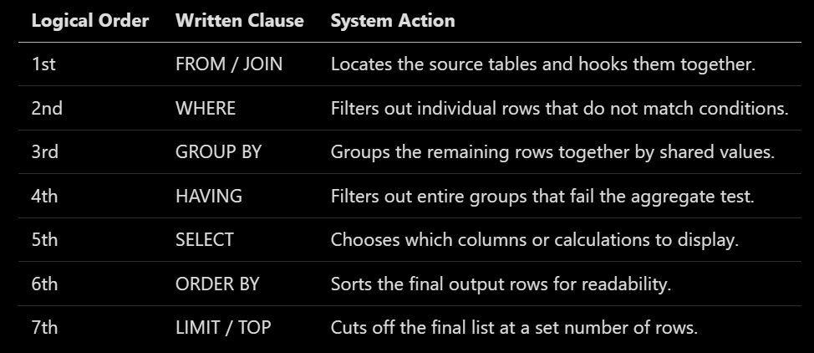
SQL Clauses
Standard Execution Order
In SQL, the execution order is entirely different from the written order. The database engine executes these clauses in a strict logical sequence to locate and process data cleanly:

Slide 61
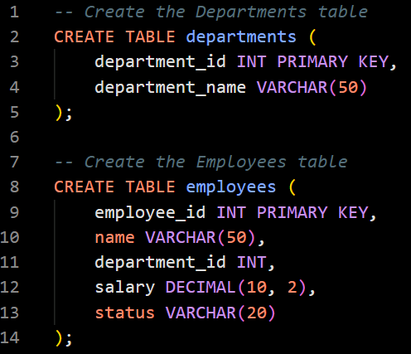
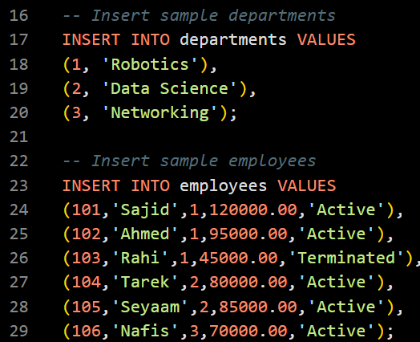
SQL Clauses Example

Slide 62
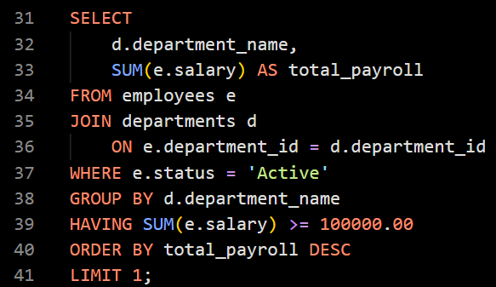
SQL Clauses Example

Slide 63
SQL Clauses Example
Step by Step breakdown
When the database runs this query, it processes the clauses in this exact logical order:
FROM & JOIN: The database loads the employees table (e) and links it to the departments table (d) using the matching department_id values.
WHERE: It immediately filters out 'Rahi' because his status is 'Terminated'. Only 'Active' employees advance.
GROUP BY: It buckets the remaining employees by their department_name ('Engineering', 'Marketing', 'Sales’).
HAVING: It sums up the salaries for each group and checks the condition.
  Robotics: $120,000 (Sajid) + $95,000 (Ahmed) = $215,000 (Kept)
  Data Science: $80,000 (Tarek) + $85,000 (Seyaam) = $165,000 (Kept)
  Networking: $70,000 (Nafis) = $70,000 (Dropped because it is under $100,000)

Slide 64

SQL Clauses Example
Step by Step breakdown
SELECT: It generates the final columns: the department name text and the calculated total_payroll sum.
ORDER BY: It sorts the two remaining departments by total_payroll from highest to lowest ('Robotics' first, then ‘Data Science’).
LIMIT: It clips the results to return only the 1st row.
Output Result:

